Slide 1
Unit 5 – Section 5 “Graphing Exponential and Logarithmic Functions”
Objectives Covered
To graph Logarithmic and exponential functions.

Slide 2
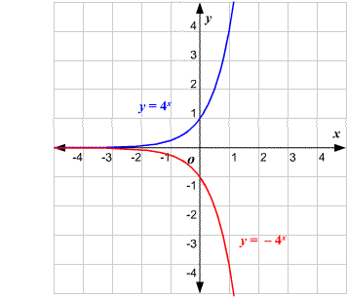
Graphs of Exponential Functions
$$y=a∙b^{x}$$
$$y=−a∙b^{x}$$
Question: How does the value of a effect the graph?

Slide 3
Graphing Exponential Functions
Parent Function for Exponential Growth Functions:
$f\left(x\right)=a∙b^{x}$ *Without any shifts
Steps:
Graph the points (0,1) and (1,b)*. If a is anything other than 1, the first ordered pair is $\left(0,a\right)$ and the second ordered pair is (1,ab).
Determine the horizontal asymptote.
Horizontal asymptote: the imaginary horizontal line the graph approaches but does not touch or cross, $y=\#$
If there is no vertical shift, the H.A. is always $y=0$.
Directions: Graph the following functions.
$y=4^{x}$
$f\left(x\right)={2∙3}^{x}$
$g\left(x\right)=−2∙3^{x}$

Slide 4

Translating Graphs (Shifting)
Steps: $f\left(x\right)=a∙b^{x}$
Graph the points (0,1) and (1,b)*. If a is anything other than 1, the first ordered pair is $\left(0,a\right)$ and the second ordered pair is (1,ab).
Apply the shifts. Note: $inside=small$
Determine the horizontal asymptote. H.A. is always equal to the vertical shift.
Graph your result.
Directions: Graph the following exponential functions.
$y=2^{x+1}$
$y=3^{x}−4$
$y=2^{x−3}−1$
+
-
₊ ₋

Slide 5
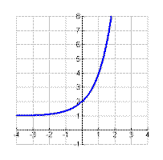
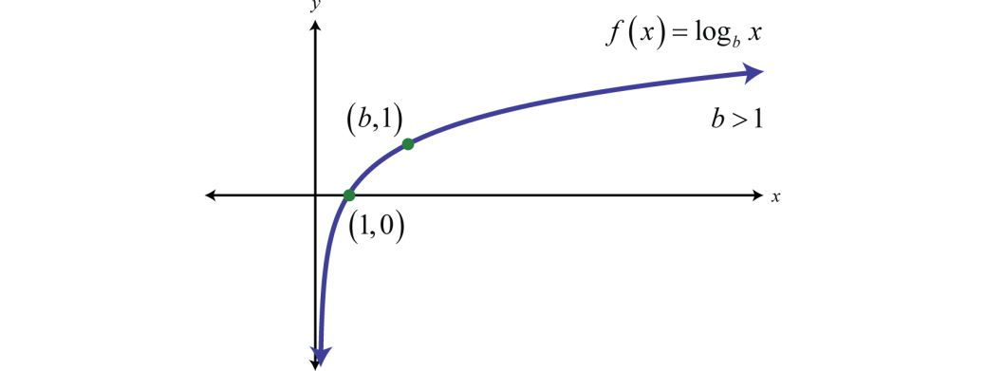
Graphs of Logarithmic Functions
$$y=b^{x}$$
$$y=\log_{b} (x)$$
Logarithmic Function: The inverse of an exponential function.

Slide 6
Graphing Logarithmic Functions
Parent Function for Logarithmic Function
$f\left(x\right)=\log_{b} (x)$
Steps:
Graph the points $(1,0)$ and $(1,b)$
Determine the vertical asymptote.
Vertical Asymptote: The imaginary vertical line the graph approaches but does not touch or cross, $x=\#.$
If there is no vertical shift, the V.A. is always $x=0$.
Directions: Graph the following functions:
$y=\log_{4}(x)$
$y=\log_{3}(x)$

Slide 7
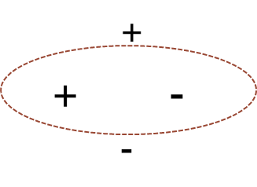
Translating (Shifting) Log Functions
$f\left(x\right)=\log_{b} (x)$
Steps:
Graph the points $(1,0)$ and $(b,1))$
Apply the shifts.
Determine the vertical asymptote. V.A. is always equal to the horizontal shift.
Graph your result.
Directions: Determine how each graph has been shifted from its default position. Graph the functions.
$y=\log_{3}(x+3)$
${y=log}_{5}\left(x−1\right)+2$
${y=log}_{4}\left(x+1\right)−4$

Slide 8
Closing Questions
Directions: Respond to the following questions. Be prepared to discuss your answers with the class.
Graph the equation $y=2^{x−3}+5$?
How do you graph the following $y=−3∙2^{x}$?
Graph the function $y=\log_{6} \left(x+1\right)−4$

Slide 9
Homework Assignment
Announcements

