Slide 1
Unit 5 – Section 7 “Modeling Exponential Functions/Regression”
Objectives
To write exponential functions using tables, calculators, and graphs.

Slide 2
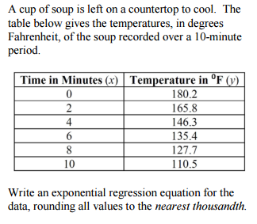
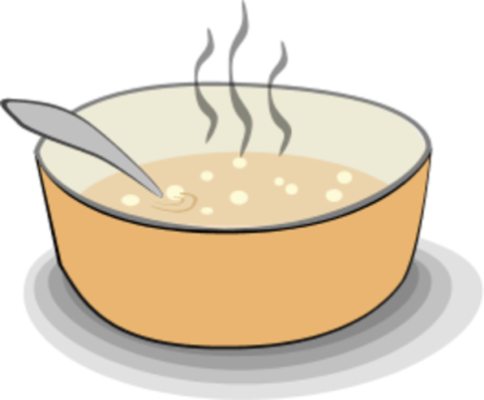
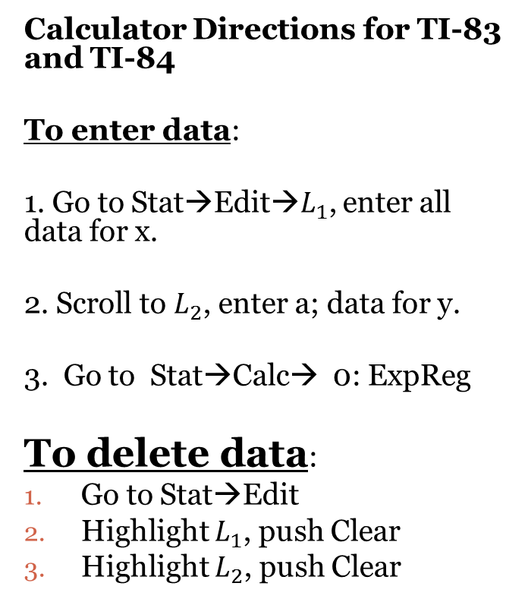
Soup Left on the Countertop
Calculator Directions for TI-83 and TI-84
To enter data:
1. Go to Stat→Edit→$L_{1}$, enter all data for x.
2. Scroll to $L_{2}$, enter a; data for y.
3. Go to Stat→Calc→ 0: ExpReg
To delete data:
Go to Stat→Edit
Highlight $L_{1}$, push Clear
Highlight $L_{2}$, push Clear
Questions:
What is the temperature of the cup of soup if it’s been left on the countertop for 20 minutes?
How long would it take for the temperature to reach 1 degree?
What is the % of decrease for this function?

Slide 3
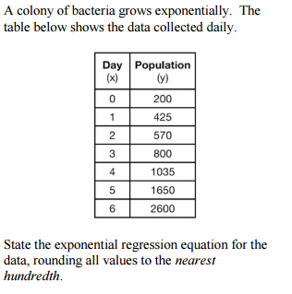
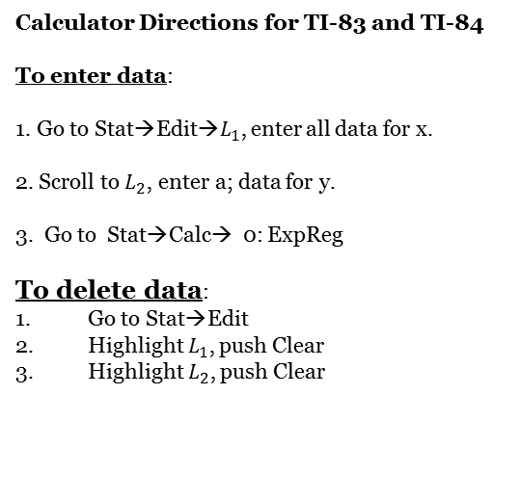
Bacteria Growth
Calculator Directions for TI-83 and TI-84
To enter data:
1. Go to Stat→Edit→$L_{1}$, enter all data for x.
2. Scroll to $L_{2}$, enter a; data for y.
3. Go to Stat→Calc→ 0: ExpReg
To delete data:
Go to Stat→Edit
Highlight $L_{1}$, push Clear
Highlight $L_{2}$, push Clear
Questions:
How many days would it take for the bacteria to grow up to 5,000?
What is the population of bacteria after 10 days?
What is the % of the growth factor?

Slide 4
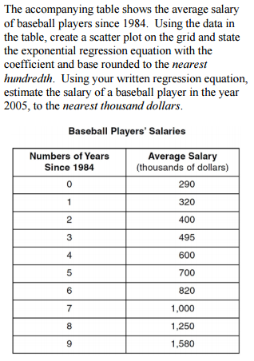
Salaries of Baseball Players
Graph the data from the table onto the graph below.

Slide 5
Homework Assignment
Announcements

