Slide 1
Unit 6 – Section 2“Multiplying and Dividing Rational Expressions”
Objectives covered
The student will be able to simplify rational expressions
The student will be able to factor and reduce rational expressions

Slide 2
Rational Numbers
Q: In the classification of numbers what is a rational number?
Rational numbers as fractions:
EX: $\frac{1}{7}$, $\frac{3}{5}, \frac{−1}{2}$
Rational Algebraic Expression: A fraction with monomials and polynomials.
Numbers/Coefficients | Monomials | Polynomials
$\frac{−4}{14}$ | $$\frac{{3a}^{2}b^{4}}{{9a}^{3}b}$$ | $$\frac{2(a^{2}+4)(b−3)}{8(a−2)(a^{2}+4)}$$

Slide 3
Rules for Simplifying Rational Algebraic Expressions
Numbers/Coefficients | Monomial | Polynomial
Divide the numerator and denominator by the greatest common factor >1. | Subtract the exponents of like variables, while remembering rules for negative exponents. | Factor polynomials and cancel matching quantities* from top to bottom only.
$$\frac{2}{6}\frac{÷2}{÷2}=\frac{1}{3}$$ 2 is the greatest common factor of 2 and 6. | $\frac{{3a}^{2}b^{4}}{{9a}^{3}b}$=$\frac{b^{3}}{3a}$ | $\frac{2(a^{2}+4)(b−3)}{8(a−2)(a^{2}+4)}$= $\frac{(b−3)}{4(a−2)}$
Note: Any of the following rules may exist more than once. For instance, notice how each example involves coefficients. *Quantities are binomial expressions $\left(a+b\right)$, and they are a unit and should not be treated separately.

Slide 4
Simplifying Rational Expressions
Directions: Simplify each polynomial. Remember to factor when necessary. Show all work. Sate the restricted values.
Restricted Value: Determining what values in the denominator that make the equation undefined.
1. $\frac{x^{2}+5x+6}{x^{2}+7x+12}$ 2. $\frac{2x+4}{x^{2}−4}$ 3. $\frac{x^{2}−8x+12}{x^{2}−7x+6}$

Slide 5
Multiplying Rational Expressions
Monomial
Polynomial
Cross cancel up/down and diagonally across (but never on the same line).
Multiply the remainders.
Reduce if necessary.
Hint: Recall rules of negative exponents.
Factor where necessary.
Cross cancel up/down and diagonally across, (but never on the same line).
List the remainders as one big rational number.
Multiply the remaining factors*.
*You may or may not be required to do this.

Slide 6

Multiplying Rational Expressions with Monomials
Directions: Find the product of each rational expressions. Reduce and simplify as much as possible. Show all work necessary.
(1) $\frac{7a}{9b}∙\frac{{63b}^{3}}{{35a}^{2}}$ (2) $\frac{{3a}^{2}b}{{9ab}^{5}}∙\frac{18a}{10b}$ (3) $\frac{{4m}^{3}}{6m}∙\frac{7m}{10}$

Slide 7
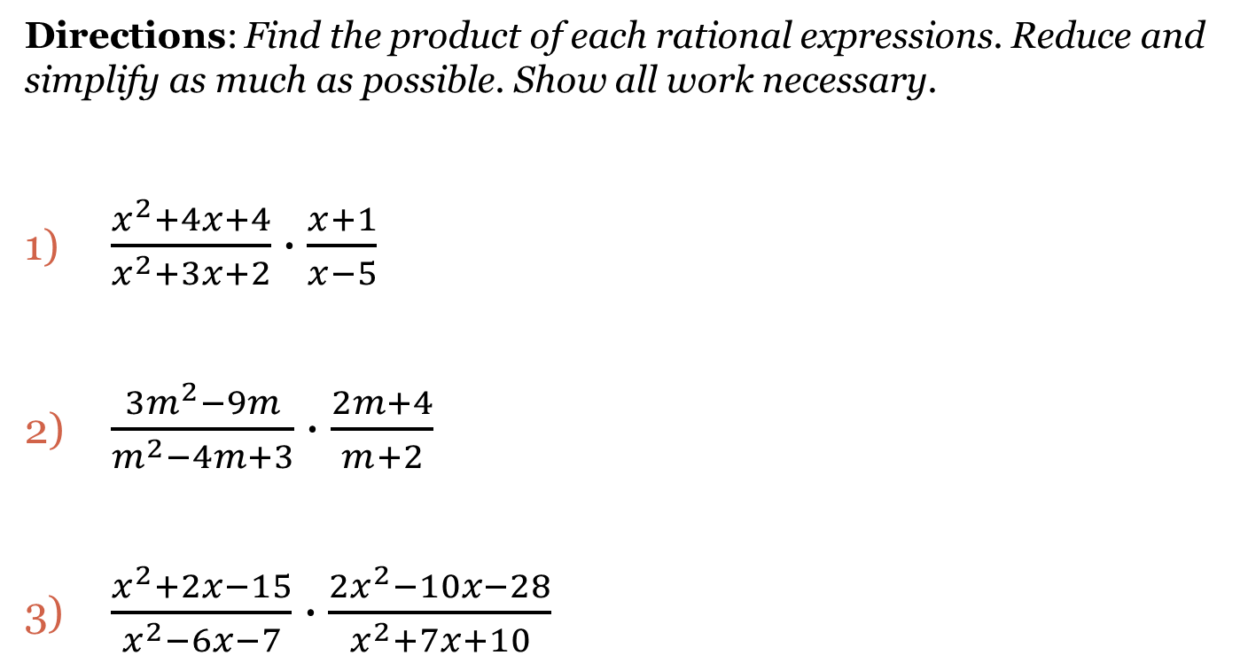
Multiplying Rational Expressions with Polynomials
Directions: Find the product of each rational expressions. Reduce and simplify as much as possible. Show all work necessary.
$\frac{x^{2}+4x+4}{x^{2}+3x+2}∙\frac{x+1}{x−5}$
$\frac{3m^{2}−9m}{m^{2}−4m+3}∙\frac{2m+4}{m+2}$
$\frac{x^{2}+2x−15}{x^{2}−6x−7}∙\frac{2x^{2}−10x−28}{x^{2}+7x+10}$

Slide 8
Dividing Rational Expressions
Steps:
Flip the second fraction and change from $÷to ×$.
Use rules for multiplication.
Directions: Find the quotient of each pair of rational expressions. Reduce and simplify as much as possible. Show all work necessary.
1. $\frac{{14c}^{2}d}{{9m}^{3}n^{3}}÷\frac{{35cd}^{3}}{24mn}$ 2. $\frac{{3x}^{2}−3}{2x^{2}+8x+6}÷\frac{{5x}^{2}−10x+5}{4x+12}$ 3. $\frac{3x+6}{7x−7}÷\frac{5x+10}{14x−14}$

Slide 9
Closing Questions
Directions: Respond to the following prompts. Be prepared to discuss your answers with the class.
Simplify the rational expressions.
1. $\frac{x+3}{10x+20}∙\frac{x+2}{x^{2}+4x+3}$ 2. $\frac{x^{2}−x−12}{x−4}÷\frac{2x+6}{x−5}$

Slide 10
Homework Assignment
Announcements

