Slide 1
Unit 6– Section 2 “Graphing Systems of Inequalities”
Objectives
The student will graph a system of inequalities

Slide 2
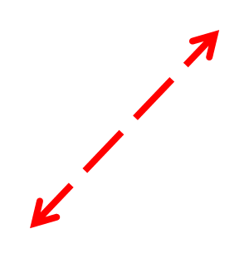
Graphs of Inequalities with a < Symbol
Less than symbol: < with a positive slope.
Less than symbol: < with a negative slope.
NOTE: A less than sign yields a dashed line and is shaded BELOW the graph

Slide 3
Graphs of Inequalities with a > Symbol
Greater than symbol: > with a positive slope.
Greater than symbol: > with a negative slope.
NOTE: A greater than sign yields a dashed line and is shaded ABOVE the graph

Slide 4
Graphs of Inequalities with a $≤$ Symbol
Less than or equal to: $≤$with a positive slope.
Less than or equal to: $≤$ with a negative slope.
NOTE: A less than or equal to sign yields a solid line and is shaded BELOW the graph.

Slide 5
Graphs of Inequalities with a $≥$ Symbol
Greater than or equal to: $≥$with a positive slope.
Greater than or equal to: $≥$ with a negative slope.
NOTE: A greater than or equal to sign yields a solid line and is shaded ABOVE the graph

Slide 6
Special Cases: Graphs of Inequalities
Graphs of $x<0 and x>0$ respectively.
Graphs of $y>0 and y<0$ respectively.
The same applies for the symbols $≤and ≥$ but with a SOLID line.

Slide 7
Symbols and Shading
< dash/below
> dash/above
< solid/below
> solid/above

Slide 8
Graphing Systems of Inequalities
Directions: Using the graph paper, graph the system of inequalities and shade in the correct solution area.
$x≥5$
$y<−x+3$
$y<\frac{−1}{3}x+2$
$y>x−4$
3) $y<−1/3x−4$
$y>\frac{2}{3}x+1$

Slide 9
Homework Assignment
Announcements

