Slide 1
Unit 6 – Section 3 “Solving Rational Equations”
Objective Covered
The student will be able to identify solutions to rational equations.
The student will be able to identify extraneous solutions in solving rational functions.

Slide 2
Solving Rational Equations
Two Rational Expressions Rule: When solving a rational equation involving only two rational expressions equal to each other, cross multiply.
Note: If the variable being solved for has an exponent, get everything equal to zero and solve by factoring.
Note: Always check for extraneous solutions.
Directions: Solve each rational expression. Show all work.
$\frac{7}{r+2}=\frac{6}{r−5}$
$(x+5)=\frac{6}{x}$

Slide 3
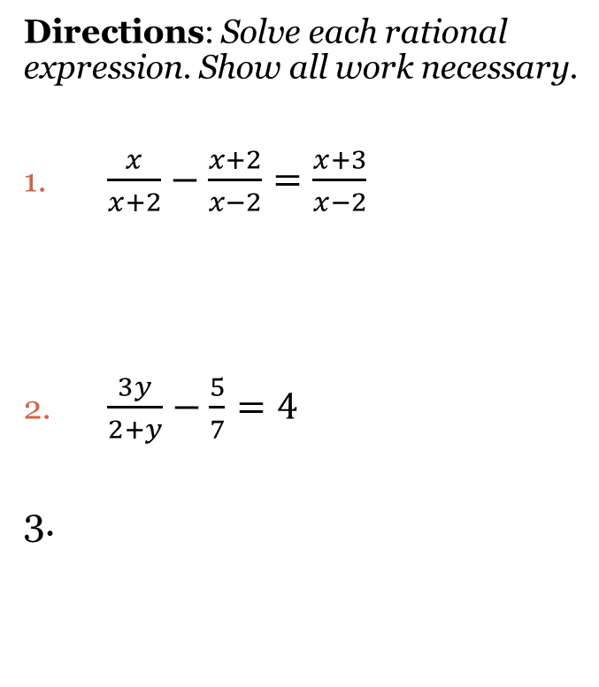
Solving Rational Equations
Steps:
Multiply the entire equation by the LCD.
Simplify each side. (Disregard the denominator at this point).
Hint: Whatever term is missing from the bottom, multiply it to the top.
Solve the equation.
Check for extraneous solutions.
Directions: Solve each rational expression. Show all work necessary.
$\frac{x}{x+2}−\frac{x+2}{x−2}=\frac{x+3}{x−2}$
$\frac{3y}{2+y}−\frac{5}{7}=4$
3.

Slide 4
Solving Rational Equations
Note: The following examples must be checked for extraneous solutions. Not all of them will work.
Directions: Solve each rational equation. Show all work necessary.
1. $\frac{x+2}{2x+1}=\frac{x}{3}+\frac{3}{4x+2}$ 2. $\frac{3}{x^{2}+3x}+\frac{x+2}{x+3}=\frac{1}{x}$
3.

Slide 5
Special Cases of Rational Equations
No Solution
Infinite Solution
Directions: Solve the following rational equation. Show all work.
$\frac{2}{x^{2}+3x−4}+\frac{1}{x−1}=\frac{1}{x+4}$
Directions: Solve the following rational equation. Show all work.
$$\frac{x}{x−2}−1=\frac{2}{x−2}$$
Note: Zero can never be on the bottom of a fraction, therefore the solution is: “All Reals” or $x≠2$.

Slide 6
Closing Questions
Directions: Respond to the following prompts. Be prepared to discuss your answers with the class.
Solve the rational equations. Check for extraneous solutions.
1. $\frac{x}{x−2}+\frac{3}{x}=2$ 2. $\frac{1}{x−2}−\frac{2}{x+3}=\frac{11}{x^{2}+x−6}$

Slide 7
Homework Assignment
Announcements

