Slide 1
Unit 6 – Section 3 “Solving Systems Using Substitution
Objective covered
To solve systems of equations by using the substitution method

Slide 2
Substitution
Steps:
Solve one of the equations for either X or Y.
Substitute that answer for the variable in the other equation.
Solve for the remaining variable.
Substitute that variable’s number back into the first equation.
Solve for the remaining variable.
Note: Change the 7 to a 6!

Slide 3
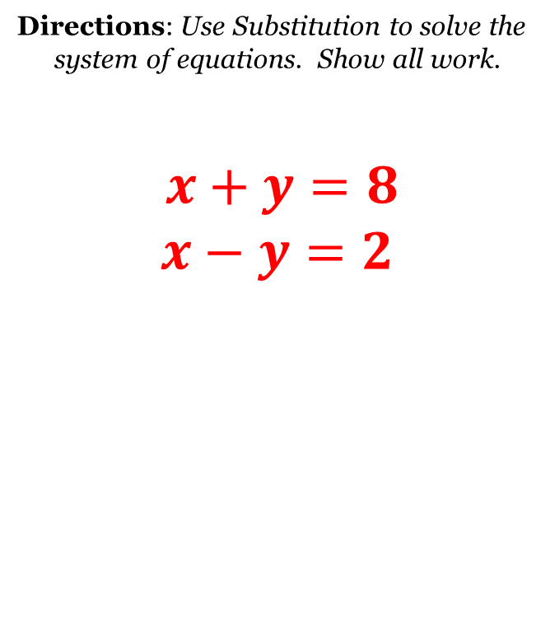
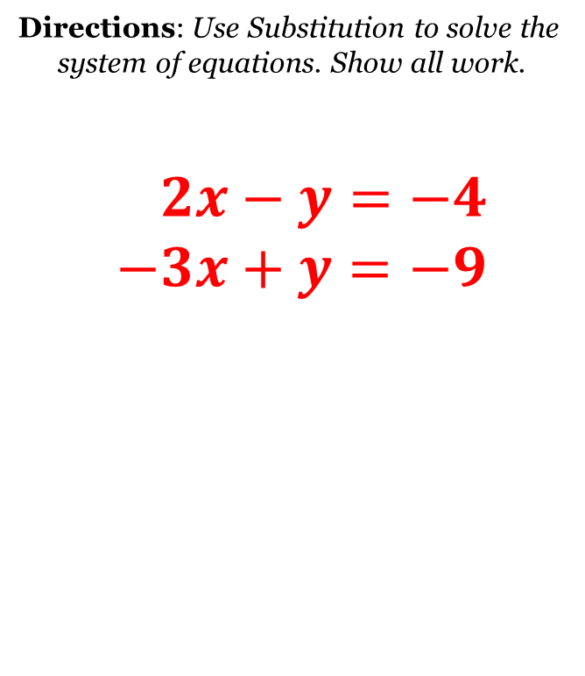


Cluster Examples
Try This:
$$\begin{matrix}2x−3y=−1 \\ y=x−1\end{matrix}$$
Try This:
$$\begin{matrix}5x−4y=−3 \\ y=−3x+5\end{matrix}$$

Slide 4
Special Case Solutions

Slide 5
Closing Questions
Directions: Respond to the following questions on a separate sheet of paper. Be prepared to discuss answers in class.
Describe the characteristics of a system that has no solution versus infinite solution when solved by using substitution.
Use substitution to find the solution to
$$y=4x+2 \\ y=3x−1$$

Slide 6
Homework Assignment
Announcements

