Slide 1
Unit 7 – Section 4 “Distribution of a Monomial to a Polynomial”
Objectives Covered
To multiply a polynomial by a Monomial
Note: Name of this section is Multiplying and Factoring

Slide 2
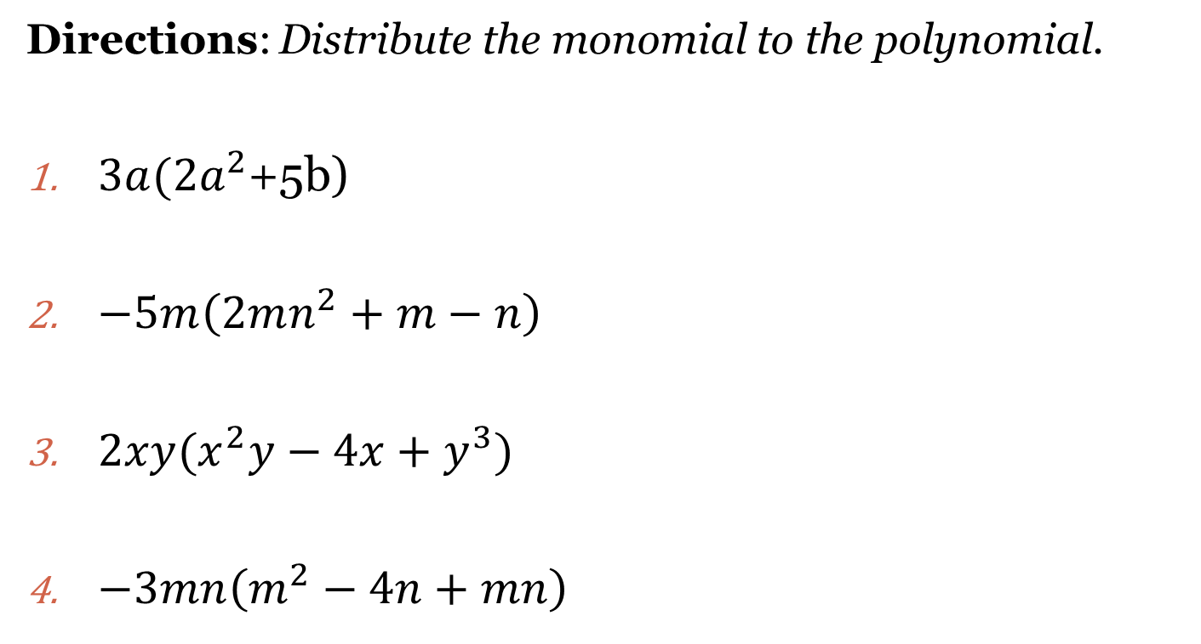
Distribution of Monomials to Polynomials
Directions: Distribute the monomial to the polynomial.
$3a(2a^{2}$+5b)
$−5m\left(2mn^{2}+m−n\right)$
$2xy(x^{2}y−4x+y^{3})$
$−3mn\left(m^{2}−4n+mn\right)$

Slide 3
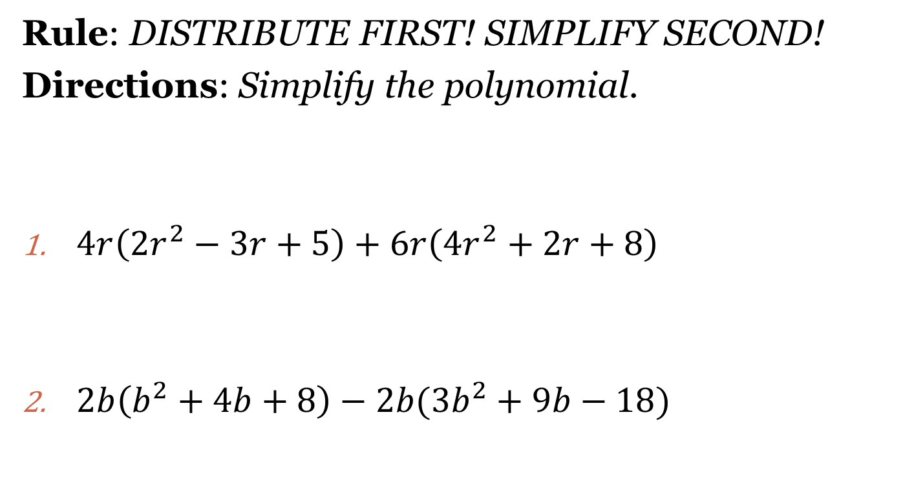
Distribution with Combining Like Terms
Rule: DISTRIBUTE FIRST! SIMPLIFY SECOND!
Directions: Simplify the polynomial.
$4r\left(2r^{2}−3r+5\right)+6r\left(4r^{2}+2r+8\right)$
$2b\left(b^{2}+4b+8\right)−2b(3b^{2}+9b−18)$

Slide 4
Homework Assignment
Announcements

