Slide 1
Unit 7 – Section 6 “Multiplying Special Cases”
Objectives Covered
To Find the Square of a Binomial.
To find the differences of Squares

Slide 2
Square of a Sum
Rule: Write each binomial twice and use double distribution.
Directions: Evaluate the binomial.
1. $(x+2)²$ 2. ${(x+5)}^{2}$ 3. $(2a+3)²$

Slide 3
Square of a Difference
Rule: Write each binomial twice and use double distribution.
Directions: Evaluate the binomial.
1. ${(x−5)}^{2}$ 2. ${(3x−1)}^{2}$

Slide 4
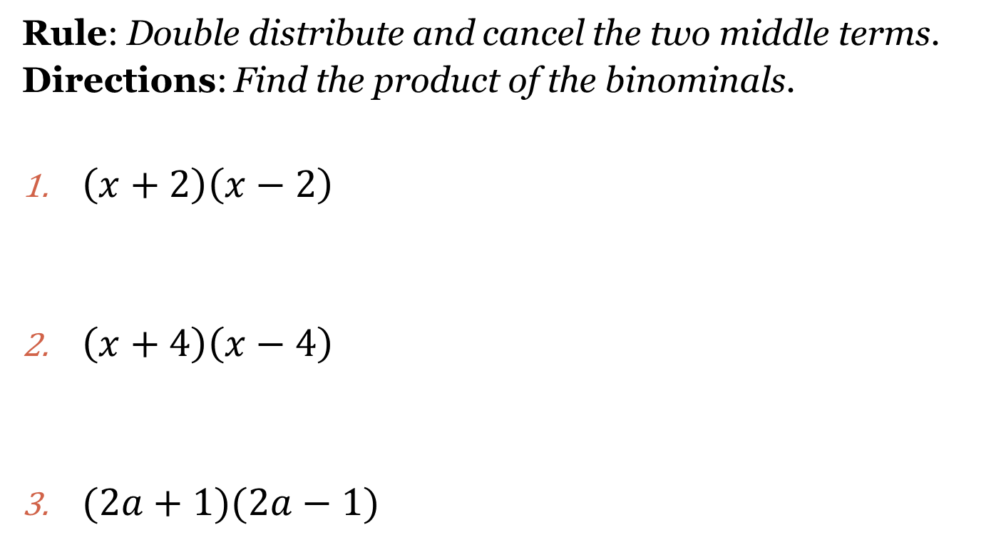
Differences of Squares
Rule: Double distribute and cancel the two middle terms.
Directions: Find the product of the binominals.
$\left(x+2\right)\left(x−2\right)$
$\left(x+4\right)\left(x−4\right)$
$(2a+1)(2a−1)$

Slide 5
Homework Assignment
Announcements

