Slide 1
Unit 8 – Section 6 “Solve by Factoring”
Objectives
To solve quadratic equations using square roots.
To solve quadratic equations by factoring.

Slide 2
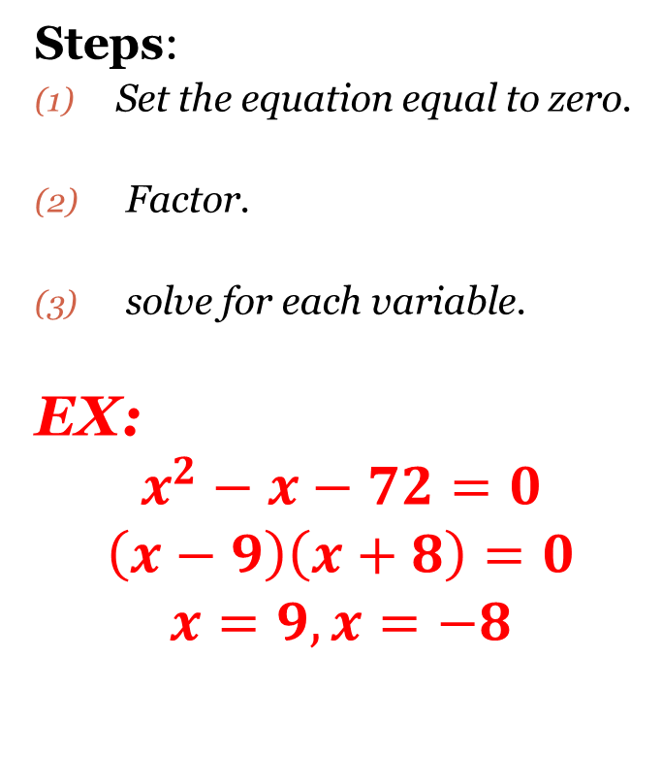
Solve by Factoring
Steps:
Set the equation equal to zero.
Factor.
solve for each variable.
EX:
$$x^{2}−x−72=0$$
$$\left(x−9\right)\left(x+8\right)=0$$
$$x=9, x=−8$$

Slide 3
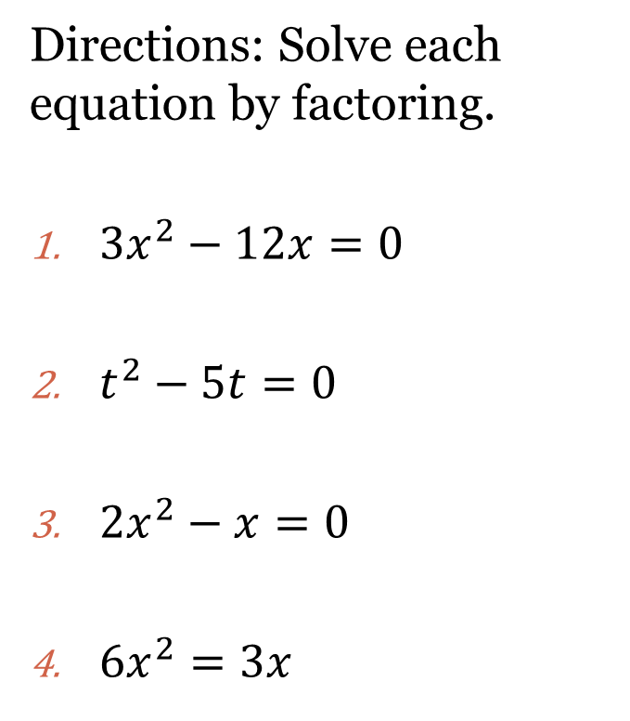
Backwards Distribution (AKA GCF)
Steps:
Set the equation equal to zero.
Factor.
solve for each variable.
Directions: Solve each equation by factoring.
$3x^{2}−12x=0$
$t^{2}−5t=0$
$2x^{2}−x=0$
$6x^{2}=3x$

Slide 4
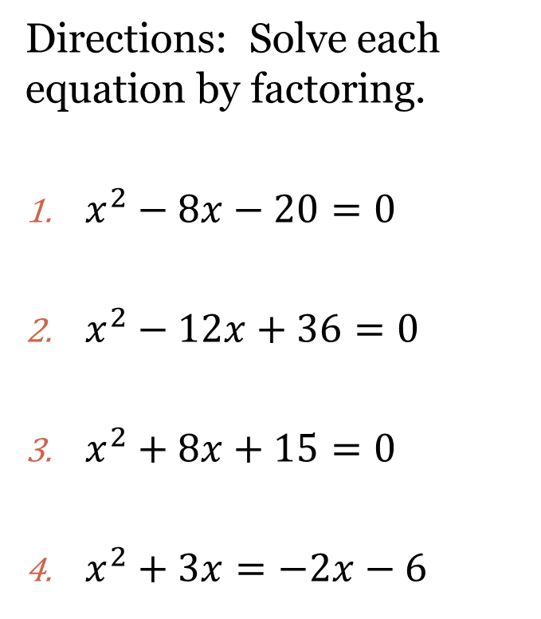
Trinomials $x^{2}+bx+c=$0
Steps:
Set the equation equal to zero.
Factor.
solve for each variable.
Directions: Solve each equation by factoring.
$x^{2}−8x−20=0$
$x^{2}−12x+36=0$
$x^{2}+8x+15=0$
$x^{2}+3x=−2x−6$

Slide 5
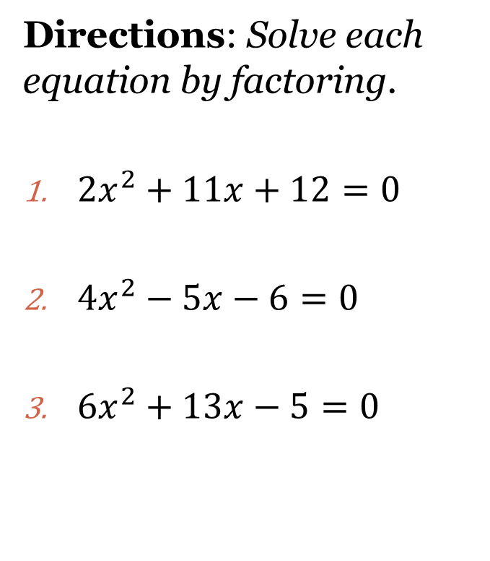
Trinomials with a Leading Coefficient $ax^{2}+bx+c=0$
Steps:
Set the equation equal to zero.
Factor.
solve for each variable.
Directions: Solve each equation by factoring.
$2x^{2}+11x+12=0$
$4x^{2}−5x−6=0$
$6x^{2}+13x−5=0$

Slide 6
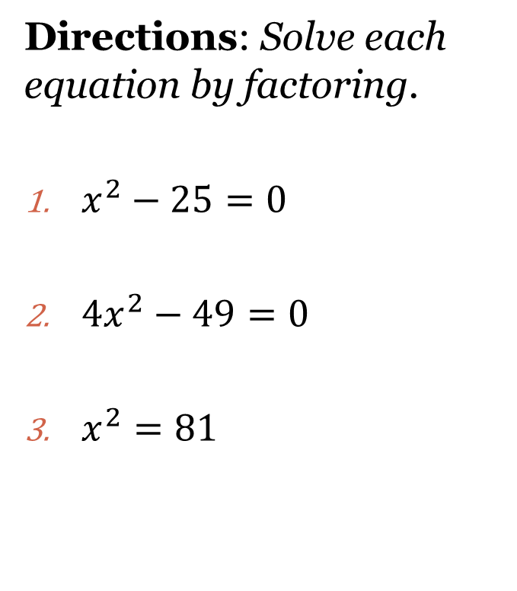
Differences of Squares $a^{2}−b^{2}$
Steps:
Set the equation equal to zero.
Factor.
solve for each variable.
Directions: Solve each equation by factoring.
$x^{2}−25=0$
$4x^{2}−49=0$
$x^{2}=81$

Slide 7
Solutions to Quadratic Functions
Root: The solution to a quadratic function.
Zero: The solution to a quadratic function.
X-Intercepts: The solutions to a quadratic function.
Solution: The x-intercepts, zeros, and roots of a function. (Notice: They all mean the same thing).
Rule: Solve by factoring, write your solutions as x-intercepts and graph the zeros.

Slide 8
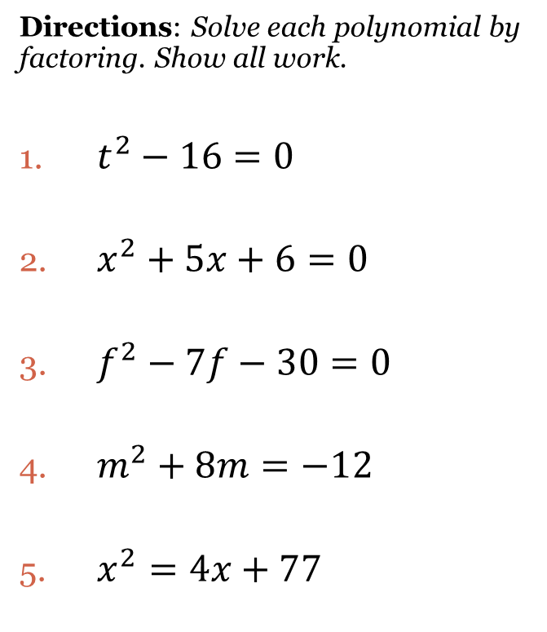
Closing Questions –Solve by Factoring
Steps:
Set the equation equal to zero.
Factor.
solve for each variable.
EX:
$$x^{2}−x−72=0$$
$$\left(x−9\right)\left(x+8\right)=0$$
$$x=9, x=−8$$
Directions: Solve each polynomial by factoring. Show all work.
$t^{2}−16=0$
$x^{2}+5x+6=0$
$f^{2}−7f−30=0$
$m^{2}+8m=−12$
$x^{2}=4x+77$

Slide 9
Homework Assignment
Announcements

